Slide 1

B.M.S. College of
Engineering
Data Visualization using Tools AAT
23DS4AEDVZ
AQI Analysis of Indian cities
Hemanth Raj M V (1BM23CD022)
Kushal KV(1BM23CD030)
Rohan R (1BM23CD051)
Prof. Lavanya Naik
Assistant Professor
Department of CSE(Data Science)
BMSCE, Bengaluru

Slide 2

B.M.S. College of
Engineering
Table of Contents
INTRODUCTION
INSIGHT ON DATASET
FEATURES EXPLORED IN POWER BI
DASHBOARD
ANALYSIS
CONCLUSION & FUTURE ENHANCEMENT
Department of Computer Science Engineering(Data Science)

Slide 3
Introduction about the project
B.M.S. College of
Engineering
• Air pollution is a growing concern in Indian cities, driven by traffic, industry, and construction activities.
• Poor air quality affects millions, contributing to respiratory issues and other health risks.
• This project uses pollution data from 2015–2017 and visualizes it using Microsoft Power BI.
• Objectives:
- Identify cities with the worst air quality.
- Analyze key pollutants like PM2.5, NOx, and CO.
- Track AQI changes over time and across regions.
• Interactive dashboards allow for easy data exploration and help uncover patterns for better environmental awareness.
Department of Computer Science Engineering(Data Science)

Slide 4
Insights on the Dataset
B.M.S. College of
Engineering
• The dataset contains air quality data from January 2015 to mid-2017, with over 29,000 records across ~25 Indian cities.
• Key columns include:
- Pollutants: PM2.5, PM10, NO, NO2, NOx, CO, O3
- AQI (Air Quality Index) and AQI Bucket
- City and Date for time-based and city-wise analysis
• Common cities: Delhi, Ahmedabad, Gurugram, Patna, Talcher, Mumbai, etc.
• Some columns have missing values; analysis focuses on well-populated fields.
• Average AQI is around 166, with peak PM2.5 and PM10 levels reaching close to 1000 — indicating severe pollution in some regions.
• This dataset forms the basis for all Power BI visualizations and insights.
Department of Computer Science Engineering(Data Science)

Slide 5
Features Explored in Power BI
B.M.S. College of
Engineering
• Power BI was used to create interactive and insightful dashboards from raw pollution data.
• Key features and visuals used:
- Line Chart – Shows overall average AQI trend from 2015 onwards.
- Area Chart – Compares PM2.5 and PM10 levels over time.
- Bar Chart – Displays average AQI by city, highlighting the most polluted ones.
- Pie Chart – Illustrates AQI bucket distribution across India.
- Stacked Bar Chart – Compares average PM2.5, PM10, and NO by city.
- Treemap – Highlights cities with frequent poor AQI readings.
- Map Visual – Plots average AQI geographically across Indian cities.
- Scatter Plot – Analyzes correlation between PM2.5 and PM10 across cities.
- Line Chart – Tracks NO₂, NOx, and NO levels over time.
- Donut Chart – Shows NOx concentration distribution by top contributing cities.
- Stacked Area Chart – Displays harmful pollutant levels (CO, NO, NO₂, NOx) by city.
- Column Chart – Compares average CO and O₃ levels across cities.
Department of Computer Science Engineering(Data Science)

Slide 6
Features Explored in Power BI
B.M.S. College of
Engineering
- Line Chart – Compares AQI trends of Delhi, Mumbai, and Bengaluru over time.
- Decomposition Tree – Breaks down AQI composition by city and year.
- Heatmap – Shows monthly AQI levels across multiple cities using color intensity.
- Box Plot – Displays variation in AQI and classification by bucket across cities.
• Custom Measures:
- Average pollutant levels, AQI trends, and % distribution by AQI Bucket using DAX.
Department of Computer Science Engineering(Data Science)

Slide 7
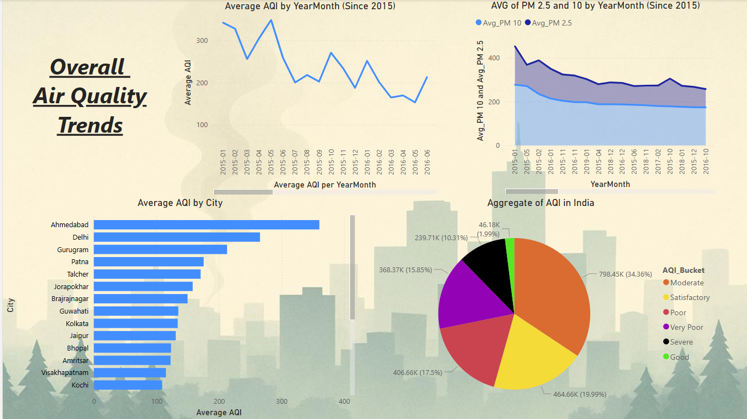
B.M.S. College of
Engineering
Dashboard
Department of Computer Science Engineering(Data Science)

Slide 8
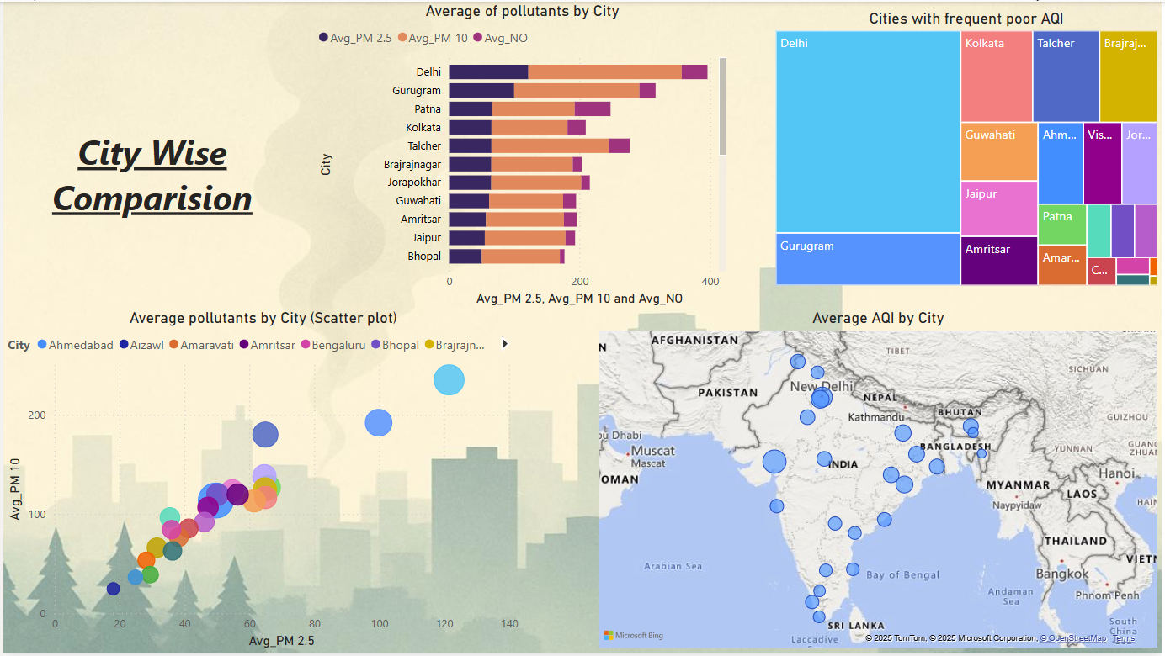
B.M.S. College of
Engineering
Dashboard
Department of Computer Science Engineering(Data Science)

Slide 9
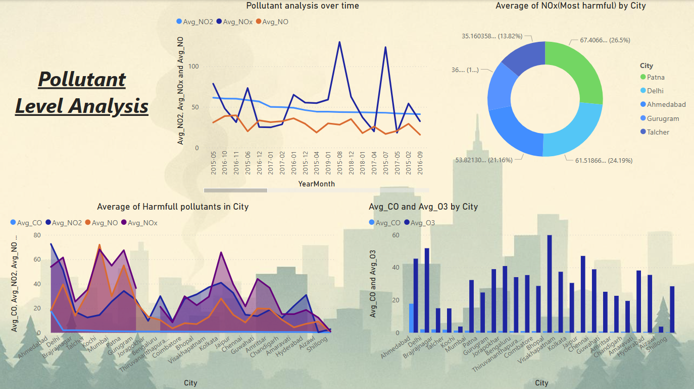
B.M.S. College of
Engineering
Dashboard
Department of Computer Science Engineering(Data Science)

Slide 10
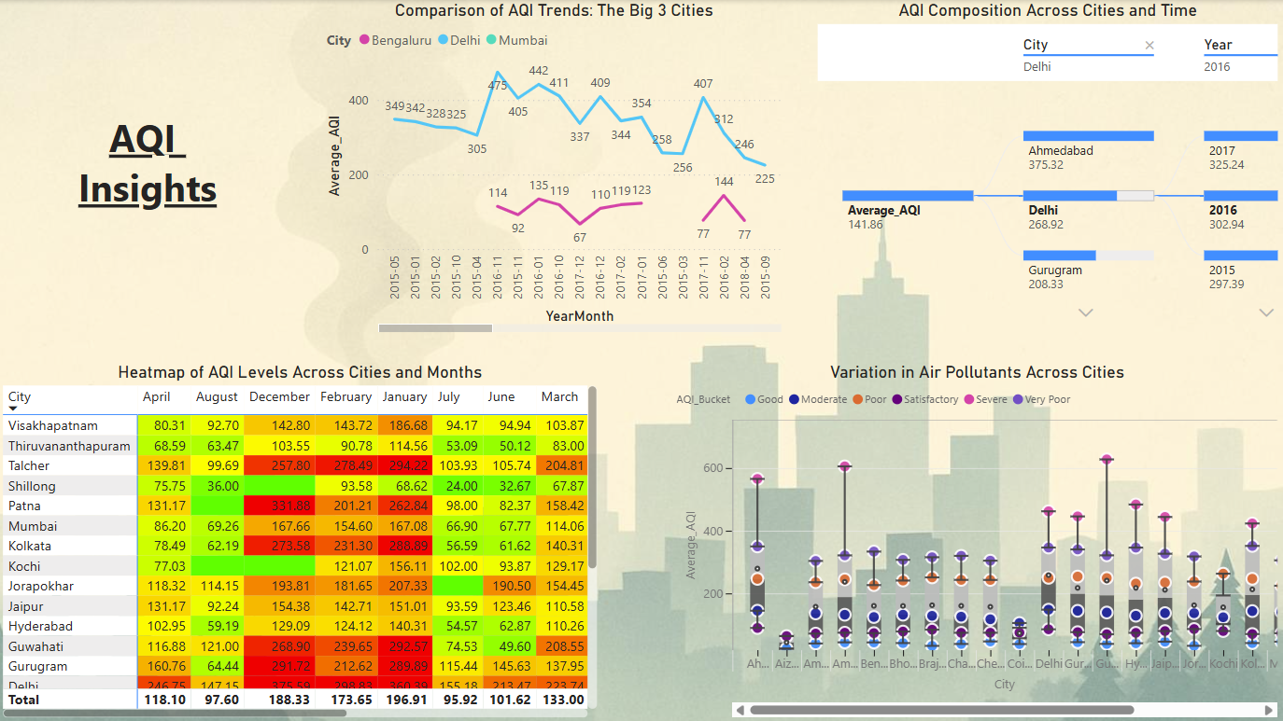
B.M.S. College of
Engineering
Dashboard
Department of Computer Science Engineering(Data Science)

Slide 11
B.M.S. College of
Engineering
Analysis
1. Cities with Highest Pollution Burden
Delhi: Average AQI of ~268.92, consistently ranks among the highest polluted cities.
Ahmedabad has the highest AQI (~375.32) among all cities displayed.
Gurugram follows with an average AQI of ~208.33.
Talcher shows exceptionally high values in specific months (e.g., AQI in February: 278.49, March: 204.81), indicating episodic pollution spikes.
2. Worst Pollutants and Their Contributors
NOx is the most harmful pollutant, with Patna (67.4), Delhi (61.5), and Ahmedabad (53.8) showing the highest average NOx levels.
Seasonal peak for NOx occurs between October and February, possibly due to lower dispersion rates and combustion-based heating sources.
Department of Computer Science Engineering(Data Science)

Slide 12
B.M.S. College of
Engineering
Analysis
3. PM2.5 and PM10 Trends
PM2.5 and PM10 values show a strong linear correlation (confirmed by scatter plot), with cities like Bhopal, Delhi, and Gurugram exhibiting values above 300+ combined levels.
Despite slight decline from 2015 to 2016, both PM values consistently remain above safe limits, indicating persistent air quality challenges.
4. AQI Bucket Distribution in India
34.36% of AQI readings fall under Moderate, while 35.7% fall under Poor to Very Poor combined, reflecting widespread hazardous exposure.
Only 1.99% of readings qualify as Good, showing that air quality is poor in most urban centers across India.
Department of Computer Science Engineering(Data Science)

Slide 13
B.M.S. College of
Engineering
Analysis
5. Geographic & Monthly Patterns
Heatmap reveals Talcher, Patna, and Delhi peak over 300+ AQI in December–February months.
Southern cities like Visakhapatnam, Kochi, and Thiruvananthapuram report relatively lower AQI values (typically under 150), except for seasonal spikes.
Cities with consistent poor AQI occurrences: Delhi, Gurugram, Kolkata, Talcher, Brajrajnagar.
6. Pollution Source Indicators
High levels of NO and NO₂ correlate with vehicular and industrial emissions—e.g., Delhi and Patna show top-tier NO levels (>60).
Ozone (O₃) levels spike in cities like Kolkata (~58) and Delhi (~50), likely due to secondary reactions under sunlight from NOx
Department of Computer Science Engineering(Data Science)

Slide 14
B.M.S. College of
Engineering
Analysis
7. Temporal AQI Trends
Delhi’s AQI reached a high of ~442 in Nov 2015, and again above 400 in Nov 2016, aligning with crop burning seasons.
While Bengaluru and Mumbai maintain better AQI (averages: Bengaluru ~114, Mumbai ~225), occasional upticks still occur in winter.
8. Interactive Visualizations for Decision-Making
Decomposition tree clearly isolates city-year level AQI contributions, facilitating root-cause understanding.
Treemaps and boxplots show frequency and severity of pollution, aiding policy planning for high-risk areas.
Department of Computer Science Engineering(Data Science)

Slide 15
B.M.S. College of
Engineering
Conclusion and Future Enhancements
Air quality in major Indian cities like Delhi, Ahmedabad, Gurugram, and Talcher remains alarmingly poor, with AQI levels often exceeding 300, especially during winter months.
NOx, PM2.5, and PM10 are the most critical pollutants, showing seasonal peaks and strong correlations with industrial activity and vehicular emissions.
Only about 2% of AQI readings fall under the 'Good' category, while a significant portion lies in the 'Poor' to 'Very Poor' range, indicating a widespread air quality crisis.
The interactive visuals made it easier to understand complex data and identify seasonal trends.
• Future Enhancements:
- Integrate real-time data using APIs for up-to-date monitoring.
- Incorporate predictive models to forecast AQI trends and alert high-risk periods.
- Expand analysis to cover post-2017 data for recent insights.
- Add deeper analysis of seasonal and festival-related pollution peaks.
Department of Computer Science Engineering(Data Science)

Slide 16
B.M.S. College of
Engineering
THANK YOU
Department of Computer Science Engineering(Data Science)

